Slide 1
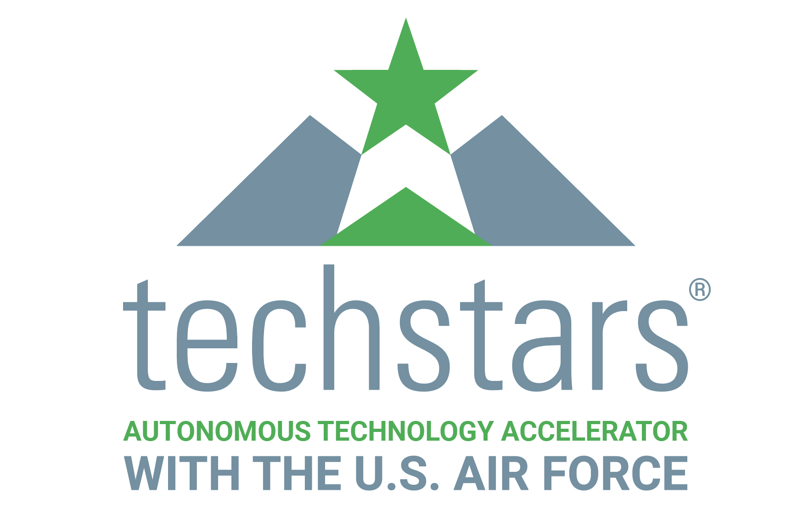
Company Lookbook
Techstars Class 119
January 22, 2018- April 19, 2018
Mentor Reception- January 3, 2018.
Confidential please do not disseminate until Jan 22, 2018.

Slide 2
The Mentor Manifesto
Be socratic.
Expect nothing in return (you’ll be delighted with what you get).
Be authentic and practice what you preach.
Be direct. Tell the truth, however hard.
Listen too.
The best mentor relationships eventually become two-way.
Be responsive.
Adopt at least one company every single year.
Clearly separate opinion from fact.
Hold information in confidence.
Clearly commit to mentor or do not. Either is fine.
“I don’t know” is preferable to bravado.
Guide, don’t control. Teams must make their own decisions.
Accept and communicate with other mentors.
Be optimistic.
Provide specific actionable advice, don’t be vague.
Be challenging and robust but never destructive.
Have empathy. Remember that startups are hard.
Month 1 Direction | Month 2 Execution | Month 3 Pitch
Meet the companies Looking for Lead mentors | Focus on one Help your company be the best one on investor day

Slide 3
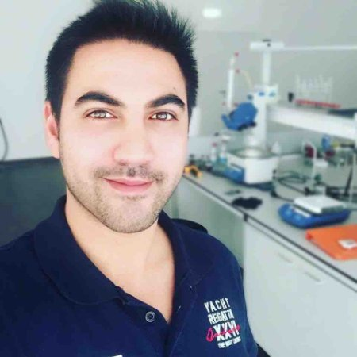
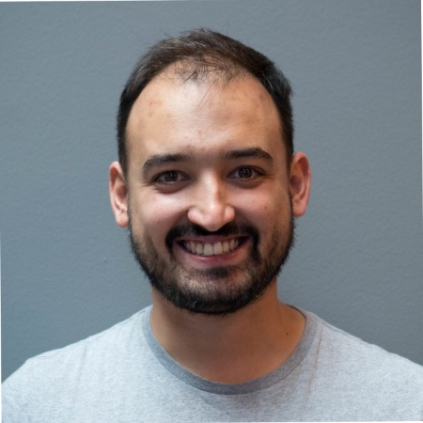
Graphenest is a nanotechnology company producing high-value graphene-based solutions. Their innovative method of production allows the conversion of graphite into high quality graphene nanoplatelets and their functional derivatives and is differentiated by an environmental friendly thermomechanical system that improves its efficiency while reducing the manufacturing costs.
Traction & Milestones
Date Founded: July 2015
-Earned 3 Seals of Excellence from the EU Commision
-Graphene Flagship Associate Member
CEO
Vitor Abrantes
CTO
Rui Silva
CSO
Bruno Figueiredo
Marketing
Bruno da Costa
@Graphenest | graphenest.com | Paradela do Vouga, Portugal

Slide 4
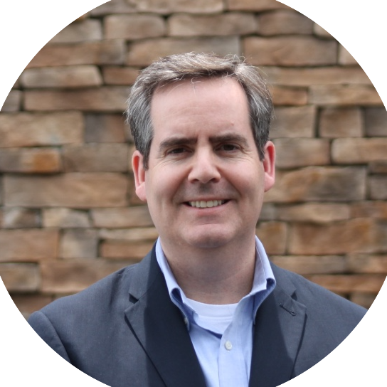
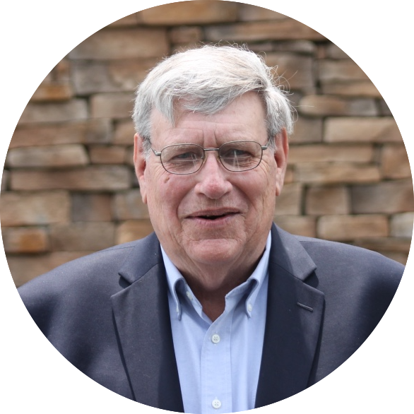
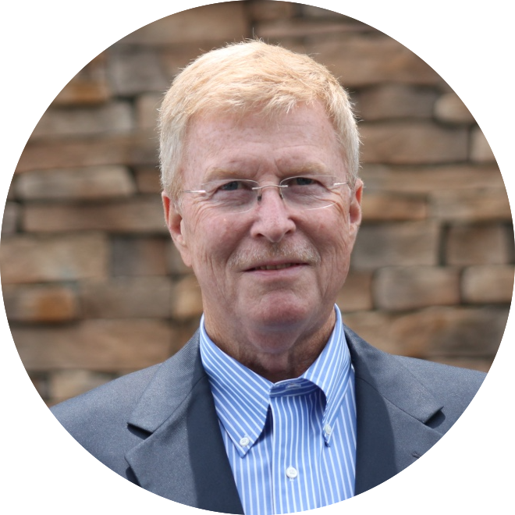
The global aviation supply chain is infested with counterfeit parts. They are difficult to detect and can cause critical systems to malfunction. SecureMarking prevents unapproved parts from entering the supply chain using blockchain-enabled authentication for components. SecureMarking labels each authentic part with a nanoparticle ink that can only be illuminated with an infrared laser. Each part is then tracked using Internet of Things (IoT) devices that record movements in a blockchain. The result is a robust, reliable, and scalable provenance for every part in the supply chain.
Traction & Milestones
Date Founded: 2016
-Received SBIR/STTR award
-Developed Case Study for AFIT on proprietary solution
CEO
Ruth Stanton
President
Daniel Stanton
CRO
Dan Quinn
Director of Research
Dr. Jeevan Meruga
Vice President
Tom Honeycutt
Senior Advisor
Rick Lee
@SecureMarking | securemarking.com | Rapid City, SD

Slide 5
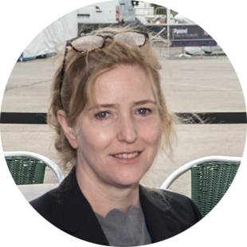
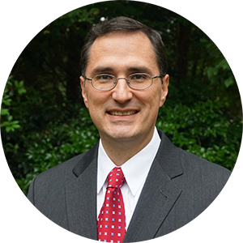
14bis Supply Tracking’s goal is to be the world’s most trusted aerospace parts integrity guarantor by bridging the physical-digital gap with its seamless binary solution for a supply chain of trust. 14bis improves aviation supply chains by providing uncompromised (incorruptible) safety through exceptional parts tracking capabilities and unparalleled customer service. Using physical imprint and blockchain technologies they provide secure tagging for each aviation part though its life cycle, which prevents unapproved parts from entering the system and increases safety and reliability. 14bis Supply Tracking provides trustworthy parts tracking, streamlining supply chain processes and combatting unapproved parts. Safer flights for people and cargo.
Traction & Milestones
Date Founded: Jan 2017
-2017 MIT FinTech Award
-2017 Accenture Innovate Award
-2017 Starburst Accelerator
-2017 AAR Corp feasibility study
-2018 partnership negotiation with IBM-Watson Transportation
-Expression of Interest: major airline, MRO and industrial group
CEO
Eleanor Mitch
CMO
Alexis Dames
CTO
Dharmesh Patel
COO
Jaime Plata
@Safeflightsio | safeflights.io | Houston, TX

Slide 6
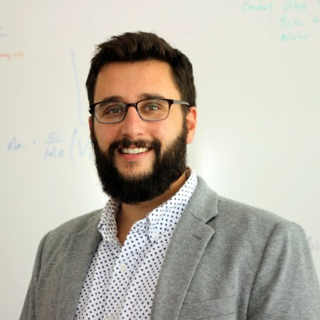
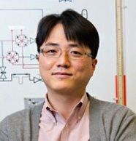
Guardion is building technology that will make the world safer from nuclear threats using city-scale radiation monitoring. Their quantum technology uses miniaturized ionizing radiation detectors, which can be deployed in large numbers to provide real-time monitoring networks for interrogating possible radioactive sources. Such networks will enable early and/or remote detection of possible radiological threats, and serve as a highly effective triage mechanism for emergency responders.
Traction & Milestones
Date Founded: May 2017
-MassChallenge: Gold Winner
-CASIS/Boeing: Technology in Space Prize
-National Science Foundation I-Corps Team
-National Science Foundation PFI AIR TT Grant
CEO
Daniel Esposito
VP Science
Swastik Kar
VP Product
Yung Joon Jung
@GuardionTech | guardiontech.com | Boston, MA

Slide 7
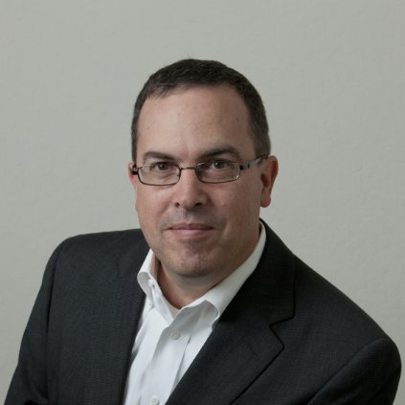
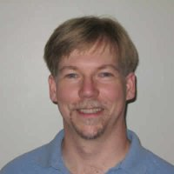
OmniPreSense develops small form factor, short-range radar allowing systems to “see” the world around them. By visualizing in the millimeter wave spectrum our solutions provide information such as speed, direction, range, and angle of arrival for objects in our field of view. Our unique IP provides detection ranges of 25-100m and utilizes electronic beam steering to enhance resolution and accuracy. With this capability, OmniPreSense brings autonomous operation to non-automotive systems including drones, robots, and other IoT solutions.
Traction & Milestones
Date Founded: Feb 2016
-MVP Launched Apr 2017
-Low Cost Radar Speed Sign design achieved over 21,000 views
CEO
Rob Frizzell
VP Software
Jim Whitfield
VP Business Development
David Yao
@OmniPSense | omnipresense.com | San Jose, CA

Slide 8
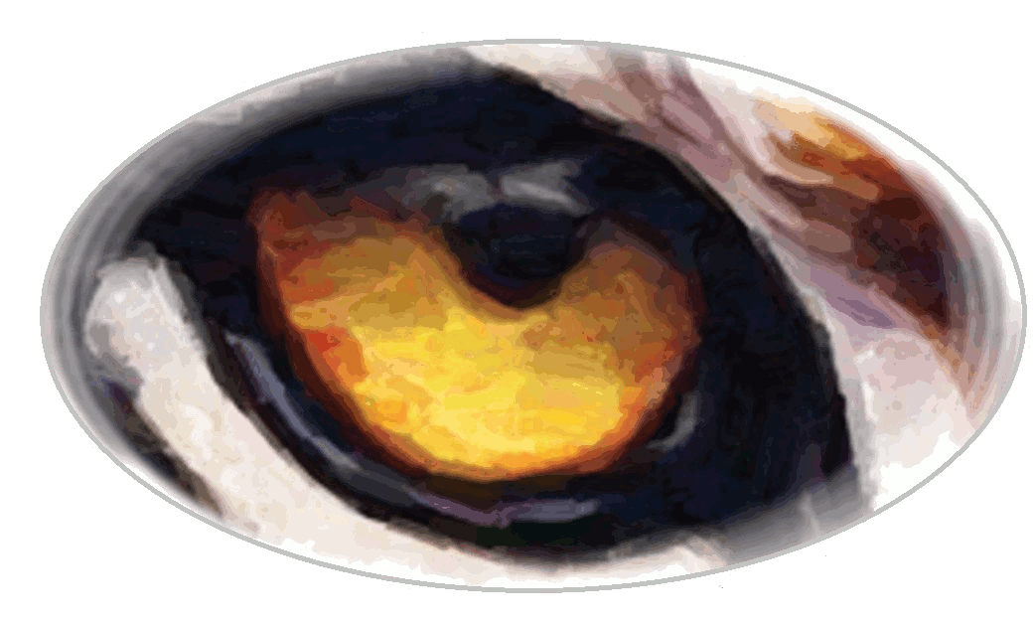
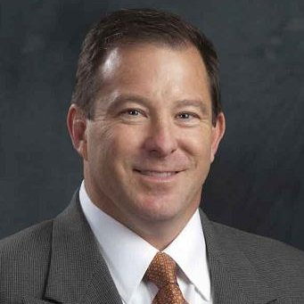
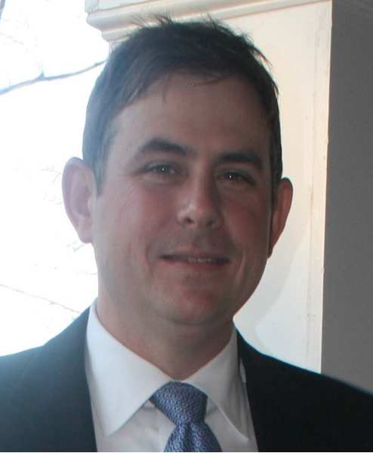
Blind Tiger Communications
Blind Tiger Communications provides government and public safety agencies a wireless security platform defending against UAS’s and Mobile Devices. Blind Tiger solves the rapidly increasing wireless security problems for global government agencies, public and private companies that require a deep and continuous understanding of assets and profiles of those devices within their facilities. Blind Tiger Communications’ flagship product is the Wireless Intrusion Detect, Defeat Security (WIDDS) platform™. WIDDS implements a communication umbrella that encompasses the customer’s facilities and provides an easy-to-use dash board that empowers customers with “1 click” insight and control of the licensed and unlicensed wireless environment.
Traction & Milestones
Date Founded: Sept 2012
-Customers in the DoD, Intelligence, Medical and Correctional Industries
CEO
Chuck Bokath
COO
Brian Stanley
blindtigercom.com | Atlanta, GA

Slide 9
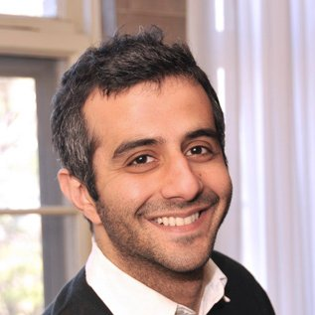
Commercial drones have omni-directional antennas that result in limited communication ranges. Notch is developing a system that solves this problem by surrounding an existing drone antenna with multiple specialized radio frequency (RF) reflector surfaces. This results in antennas that can dynamically change their radiation pattern to boost signal in any direction, while simultaneously protecting against RF jamming attacks. Our solution would be lighter, cheaper and extend battery life. Our technology is ideally suited for the drone market and can be extended to other markets such as cyber-security, mobile networks and IoT.
Traction & Milestones
Date Founded: Dec 2017
- Designed and simulated antenna system using electromagnetic simulation software.
- Designed and tested first fully addressable antenna system with electronically controllable surfaces.
- Wrote AI/machine learning algorithm to optimize range boost/jamming protection.
CEO
Shahriar Khushrushahi
CTO
Wardah Inam
Cambridge, MA

Slide 10
Robodub has built a unified drone platform for package delivery, counter-drone and military applications. Robodub's multi-rotor drones are significantly more agile and safer than competition drones. These drones also have enhanced capability to carry multiple packages, odd shaped or lopsided packages and dynamic payloads like sling payloads. The secret sauce is patent pending and award-winning Morphing drone technology. While a conventional multi-rotor drone has fixed geometry, Robodub’s design allows each arm to articulate independently and each rotor to slide along the arm independently. Unlike conventional drones, position of center of thrust can be varied in real time by our proprietary sensing and actuation control software.
Traction & Milestones
Date Founded: Nov 2014
Received government funding from Joint Center for Aerospace Technology Innovation at Washington State
Awarded a government contract
CEO
Parminder Devsi
CTO
Suvro Datta
@robodubinc | robodub.com | Seattle, WA

Slide 11
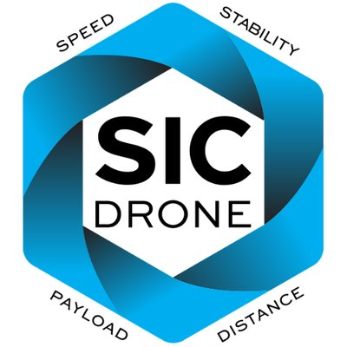
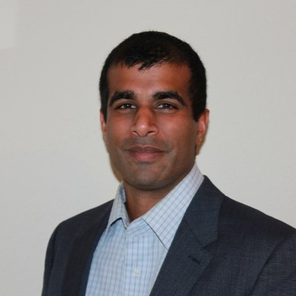
SICdrone has developed the first tiltrotor enabled multicopter—an all-weather aircraft system capable of unprecedented speed and maneuverability. With a 360 degree tiltrotor, their aircraft rotates left and right propellers to direct thrust for higher performance including unmatched acceleration, deceleration, stability, maneuverability, power efficiency, higher cruise speeds and top speed capability that meets the FAA speed limit of 100mph.
Traction & Milestones
Date Founded: Jan 2016
-2016 Jaguar Land Rover Tech Incubator
CEO
Dan Bosch
CFO
Neil Puri
Lead Aerostructure Engineer
Cory Mefford
@sicdrone | sicdrone.com | Portland, OR

Slide 12
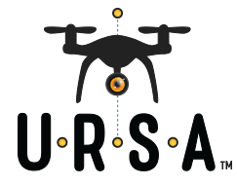
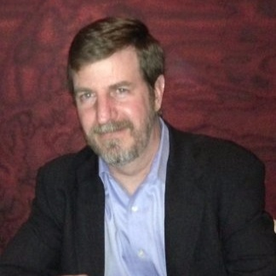
URSA applies subject matter experts, meticulous research, and machine learning to collect and analyze a wide array of UAS evidence. By using well established digital forensics standards to support the analysis of these systems, URSA provides the most accurate understanding of data and metadata to support academic, law enforcement, insurance, and intelligence investigations in the rapidly evolving unmanned vehicle and robotics ecosystem.
Traction & Milestones
Date Founded: Feb 2015
-Conducting case work for:
U.S. FAA and CBP
U.S. and UK LE Agencies
CEO
David Kovar
COO
Ben Barrows
Business Development
Justin Adams
@ursanalysis | ursasecure.com | Exeter, NH

