Slide 1
Cultivating a Culture of Workplace Civility “Implications for the Future”
Government’s Next Generation
Recruiting and Managing the Federal Workforce
October 2018
Presented by Ray Crawford, PhD.

Slide 2
Agenda
What is Civility?
The Dimensions of
Civility
Incivility – Impacts & Implications
Why does it matter?
How are YOU showing up?
Tips and Challenges…

Slide 3
What is Civility?

Slide 4
What does Civility look like?

Slide 5
The Dimensions of Workplace Civility
Engagement
Respect
Communication
Civility

Slide 6
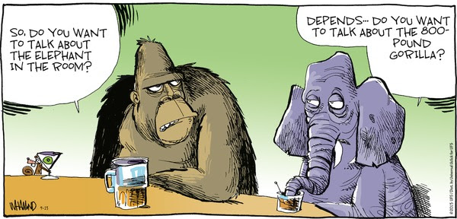
Incivility…
Bullying Gossip Entrenchment Rudeness Hostility Exclusion

Slide 7
Impacts of Incivility on Culture
Work effort decreases
Quality of work decreases
Performance declines
Teamwork erodes
Commitment to the organization declines
Hostility increases

Slide 8
Implications on the Future
s

Slide 9
Why does it matter?

Slide 10
The Greatest Obstacle
“The whole country wants civility. Why don't we have it? It doesn't cost anything. No federal funding, no legislation is involved. One answer is the unwillingness to restrain oneself. Everybody wants other people to be polite to them, but they want the freedom of not having to be polite to others.”
- Judith Martin

Slide 11
How are YOU showing up?

Slide 12
Tips for Cultivating Civility
Consider
Create
Monitor
Understand
Engage
Communicate
Accept
Adopt
Include
Influence

Slide 13
The Challenge…
What do YOU need to START doing to strengthen Respect in YOUR office?
What do YOU need to CONTINUE to do that is strengthening Engagement ?
What do YOU need to STOP doing right now in order to strengthen a culture of Civility in YOUR workplace?

Slide 14
Final thought…
“Civility is a work of the imagination, for it is through the imagination that we render others sufficiently like ourselves for them to become subjects of tolerance and respect, if not always affection.”
-Benjamin Barber

Slide 15
Contact Information
Ray Crawford, PhD.
ray.crawford@ed.gov
Office: 202-377-3426
Cell: 202-641-6952

